Slide 1

Springboard Data Science Career Track Program
Capstone Project #1
Author: Ashish Mohan Sharma
Reviewer: Srdjan Santic
Publish Date: 02/27/2019

Slide 2
INTRODUCTION
Health insurance marketplaces, also called health exchanges, are organizations in each state through which people can purchase health insurance.
A service that helps people shop for and enroll in affordable health insurance.
The federal government operates the Marketplace, available at HealthCare.gov, for most states. Some states run their own Marketplaces.
Small businesses can use the Small Business Health Options Program (SHOP) Marketplace to provide health insurance for their employees.
ACA(Affordable Care Act) or Obamacare, health exchanges were fully certified and operational by January 1, 2014, under federal law.
Since the inception of the exchange, in year 2014, ACA has been the hot topic of discussion across the U.S.

Slide 3
Problem Statement
Many type of plans are offered in various states of United States.
Each Plan is attached to different Benefits and Limitations
According to the plan and their associated benefits, monthly premium price is tagged to each plan.
Nightmare for the member to choose and buy right kind of plan which can serve more benefits with less premium.
My work will help in understanding the trend of monthly premium in different states and assist in knowing which states are offering best plans with optimum premium

Slide 4
Potential Clientele
Companies selling health insurance in state based marketplace or federal run exchange or private plan outside the marketplace.
Few examples: Freedom Life Insurance Company of America, CIGNA Health and Life Insurance Company, Celtic Insurance Company, Blue Cross and Blue Shield, Aetna Life Insurance Company.
It may also help the members for future budgeting of their health cost.

Slide 5
DATA ACQUISITION
The Health Insurance Exchange Public Use Files (Exchange PUFs) are available for plan years 2014 to 2019 to support timely benefit and rate analysis.
The link to the datasets are:
https://www.cms.gov/cciio/resources/data-resources/marketplace-puf.html
http://www.nber.org/data/cms-marketplace.html
Files used for the analysis are:
Rate File
Plan Attributes file
Benefits and Cost Sharing file

Slide 6
DATA WRNAGLING AND CLEANING - 1
Bringing the data to the desired format:
Merge the datasets from the different years into 1 dataset.
2017-2019 data columns were different then previous year, so either removed them or changed into desired naming convention
Removed columns which were not required to for analysis purpose
Imputation
Replace the missing or NAN values with logical imputation
Outliers
As the amount of data is huge and very small number of data is outlier, so I deleted the record.
Duplicate Rows
Delete the duplicate rows as it may lead to overfitting and will work badly on the unseen data

Slide 7
DATA WRNAGLING AND CLEANING - 2
Columns with “$” sign: to remove the prefix “$”, used replace function and pandas ‘to_numeric’ function.
‘Age’ and ‘RatingAreaId’ columns changed from object data type to numeric for prediction model.
‘MetalLevel’ column changed to numeric data type using OneHotEncoder.
Feature Engineering
Took the difference of Plan Start Date and Plan End Date and create the new feature ‘Duration’
Create a new column ‘Number of benefits’ by counting the number of benefits offered in the plan
Sum up the ‘IndividualRate’ and ‘IndividualTobaccoRate’, to create the new target variable as ‘IndividualRateTotal’
Target Variable is changed to Logarithmic as ‘IndividualRateTotalLog’

Slide 8
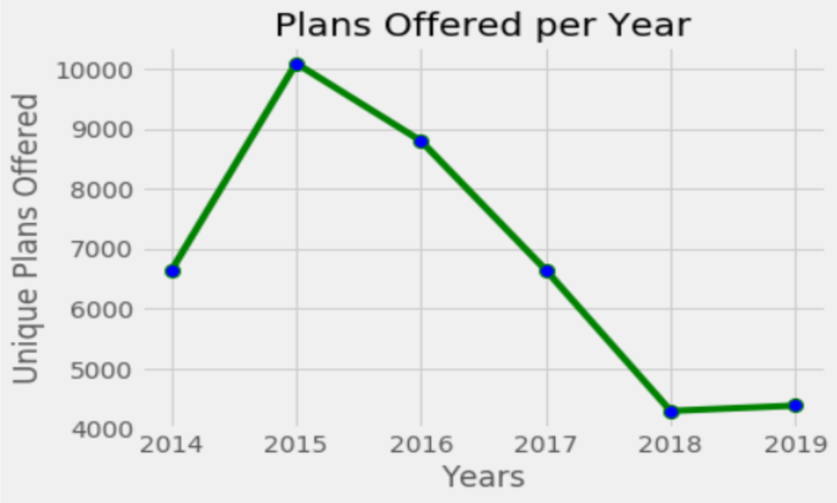
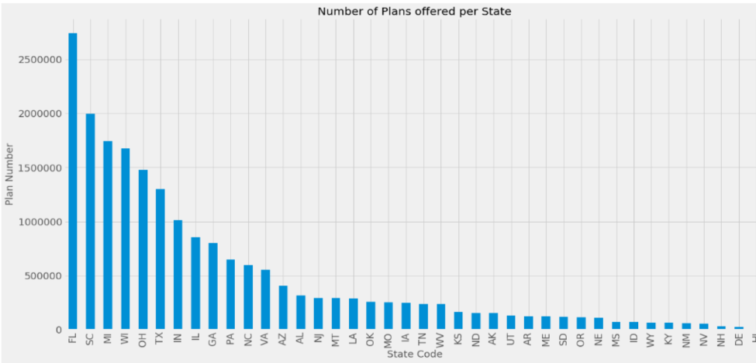
EDA – Plans offering per state per year
There is a dramatic change in the number of plans offered in Healthcare market.
More than 10,000 plans were offered in 2015, reduced to 4,000 in 2019.
Florida is one of the state which offers the maximum number of Plans to its population
Alaska and Illinois are not offering that many plans. As these states are sparsely populated so they don’t have leverage to provide so much of choice in Plans

Slide 9
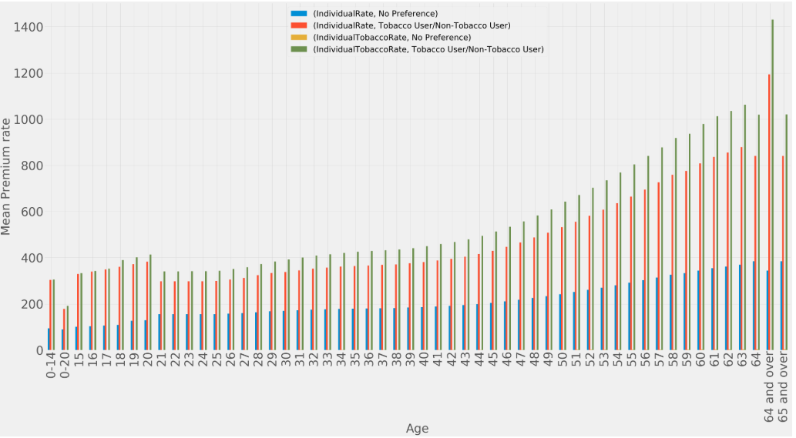
EDA – Premium vs Age vs Tobacco User
Health Insurance rates go up as a policyholder gets older, with the largest increases coming after age 50.
Consumers, 64 and older have their premiums capped at 3 times the premiums of the 21 year old base rate.
There is a constant increase of premium as member ages and it will increase more if the member is a Tobacco user.
The premium rate for Tobacco user is more than double of Non Tobacco user. This is a good incentive for living a healthy life.

Slide 10
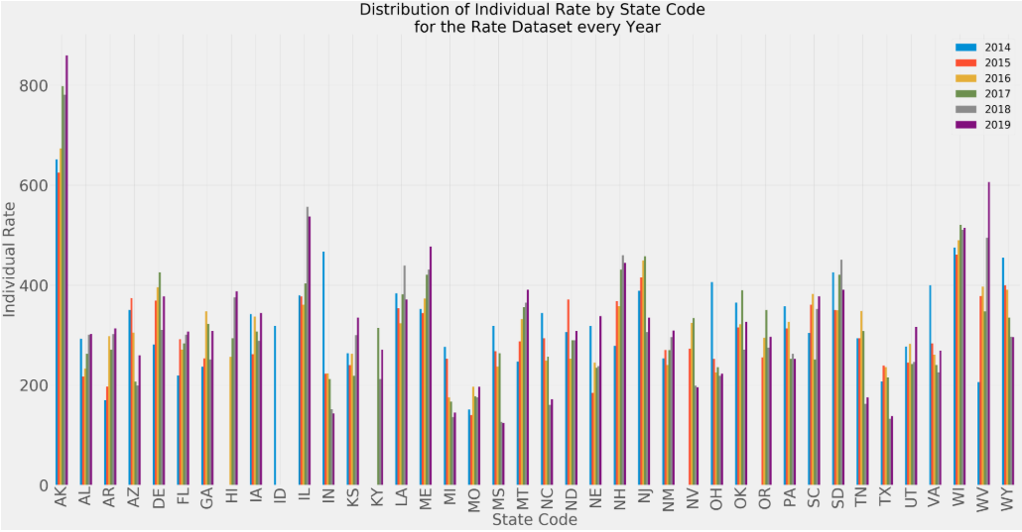
EDA – Which State is expensive
Out of 50 states only 40 states have participated in this exchange program
There are big differences between the states. It's clear that the individual rates in Alaska and Illinois are very high.
The Median of Alaska is also very high, which means that there are no Plans which comes cheaper in this state
Tennessee and Texas are the more reasonable states with regards to Individual Plans
Negative co-relation of Number of plans offered with monthly premium in a State

Slide 11
EDA – Which State is expensive
Medical Plans benefits overview
BusinessYear | Benefits
 | count | unique | top | freq
2014 | 1134699 | 339 | Mental/Behavioral Health Outpatient Services | 15247
2015 | 2038625 | 387 | Home Health Care Services | 26991
2016 | 1737894 | 317 | Orthodontia - Adult | 23138
2017 | 1298219 | 228 | Accidental Dental | 18568
2018 | 808437 | 191 | Mental/Behavioral Health Outpatient Services | 11565
2019 | 947765 | 193 | Routine Dental Services (Adult) | 13618
Dental Plans benefits overview
BusinessYear | Benefits
 | count | unique | top | freq
2014 | 34508 | 172 | Basic Dental Care - Child | 3532
2015 | 40661 | 141 | Orthodontia - Adult | 4278
2016 | 36361 | 164 | Orthodontia - Adult | 3859
2017 | 26056 | 62 | Basic Dental Care - Child | 2803
2018 | 21215 | 70 | Basic Dental Care - Child | 2292
2019 | 19285 | 60 | Basic Dental Care - Child | 2077
Few of the benefits are still in the Medical Benefit plan as they are the plans which give both Dental as well as Medical benefits
Number of Medical plans decreases from the year of inception.
Maximum number of plans were offered in 2015 but by 2019 it was reduced to 193 from 387, almost 50% reduction.
Same reduction is in Dental care as well.
This is not a good sign of the marketplace!!

Slide 12
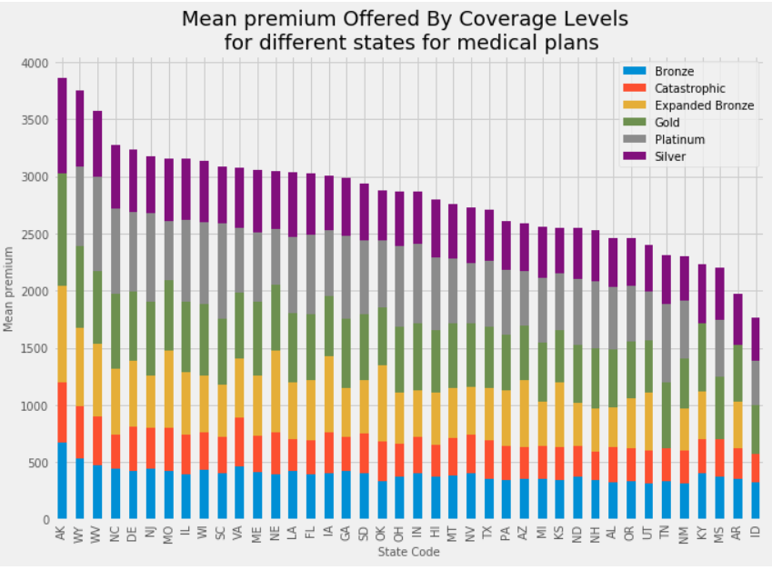
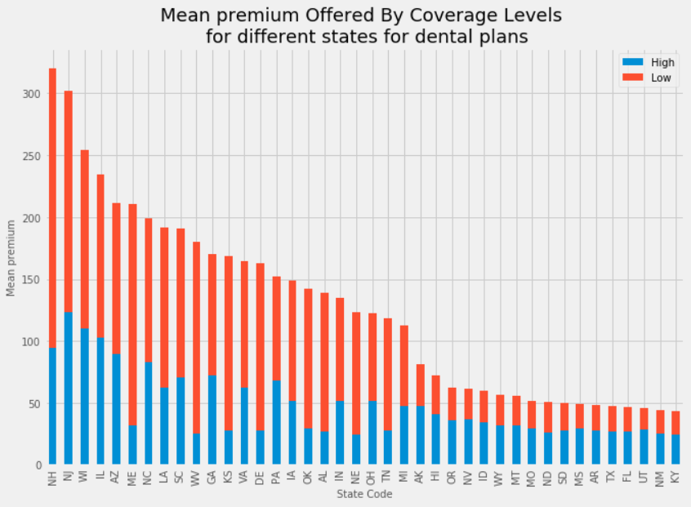
EDA – Which Plan type is expensive?
As expected Platinum plan category is expensive
Bronze plan catgory is not the least expensive. Catastrophic plans are for specific needs only so they are cheaper but covers few benefits only
Plan Type ‘Low’ for the dental plan are expensive.
To our surprise Dental insurance is not expensive in Alaska. In fact it is way cheaper than many states.

Slide 13
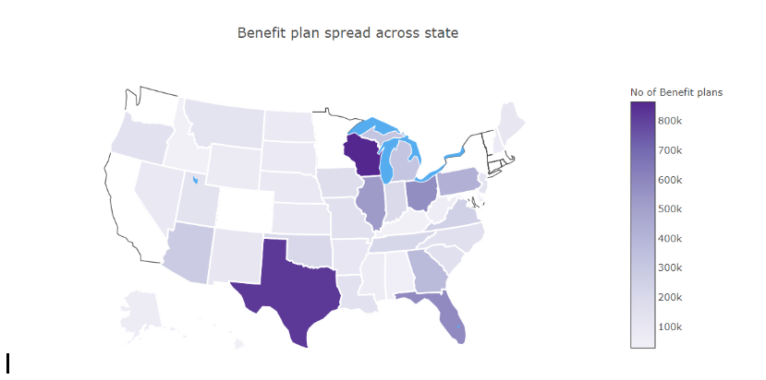
EDA – Benefit Spread Across States
Wisconsin, Texas and Florida top 3 states to offer highest number of plans.
In 5 years total of 7.2 Million plan benefits offered to the American people.
Out of those 7.2 Million plan benefits 964 were unique

Slide 14
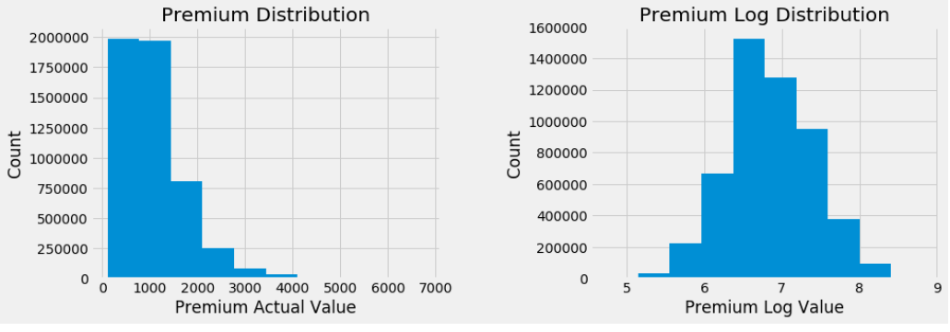
Machine Learning : Data Preprocessing
Build Regression models to predict the individual premium rates for the Florida State.
Change ‘int64’ to ‘int32’, ‘float64’ to ‘float32’ and object/categorical type of data to ‘category’ data type to save space.
Convert the total premium rate to the ‘log’ scale so that its distribution is Normal.
One Hot Encoding on all my categorical variables.

Slide 15
ML : Model Training Strategy
Training , Validation and Test Dataset
2019 dataset will be used for as Hold Out dataset. Model evaluation will be done on this test dataset
2014-2018 datasets will be used as the training dataset
2014-2018 training dataset will be split into training and validation dataset for hyper parameter tuning or Cross validation purpose
Models will be evaluated on R-square, Mean Square Error, Mean Absolute Error and Accuracy metrics.
Baseline Prediction : Predict average of monthly Premium of all the plans from 2014-2018 for the 2019 premium for all plans. Received Negative R-Square value, which suggests it cannot explain any variation in the Test Dataset

Slide 16
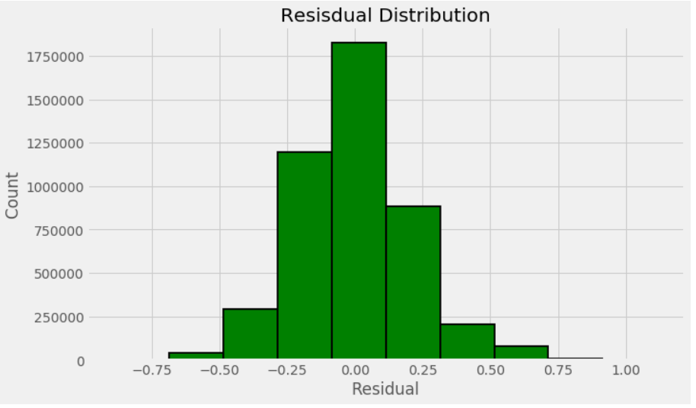
ML : Ordinary Least Squares (OLS)
OLS Summary Result 1
Dep. Variable: | Model: | Method: | Date: | Time: | No. Observations: | Df Residuals: | Df Model:
IndividualRateTotallog | OLS | Least Squares | Mon, 25 Feb 2019 | 22:08:05 | 4531151 | 4531136 | 14
R-squared: | Adj. R-squared: | F-statistic: | Prob (F-statistic): | Log-Likelihood: | AIC: | BIC: | Covariance Type:
0.848 | 0.848 | 1812000 | 0 | 682010 | -1364000 | -1364000 | nonrobust
OLS Test Run Metrics
Mean Absolute Error | 0.166688
Mean Square Error | 0.041974
R square | 0.823046
OLS Train Run Metrics
Mean Absolute Error | 0.159717
Mean Square Error | 0.04333
R square | 0.848488
R-Square value on the training dataset is .848
Residual Distribution is almost normal with a bit of right skewness.
R-Square on Hold-Out dataset is .823, which of course better than our Base Model.
Right skewness suggests that OLS or linear Regression is not the best model to explain the variance. It encourages us to explore other methods now.

Slide 17
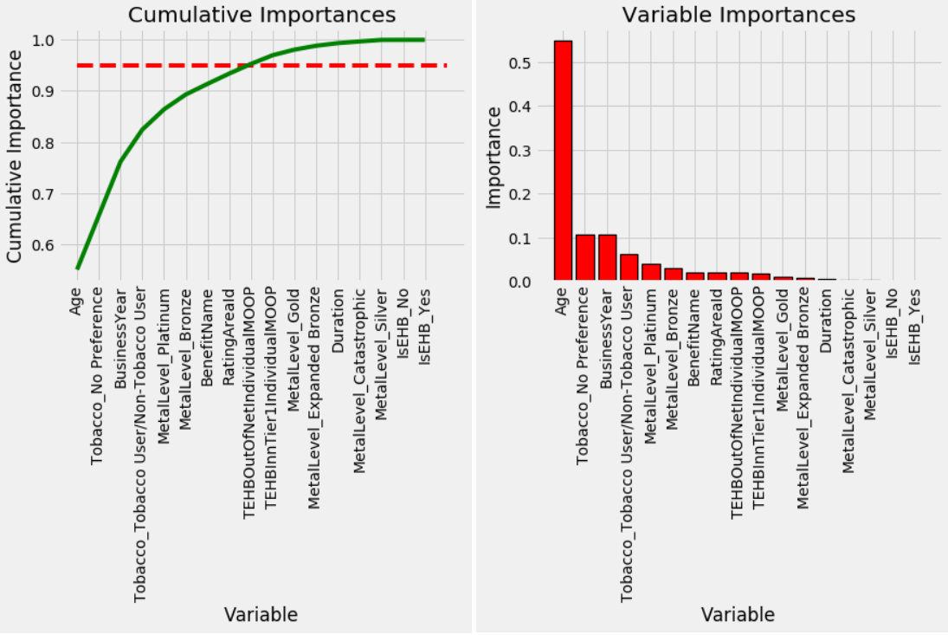
ML : Decision Tree Regression
Decision Tree regression helped us to identify the most important features in our dataset
Cumulative Importance graph suggest that 95% of the variance can be explained by half of the variables in the dataset.
‘Age’ alone explains more than 50% of the variation. So it is the most important variable. It also confirms our EDA finding as well about the ‘Age’.

Slide 18
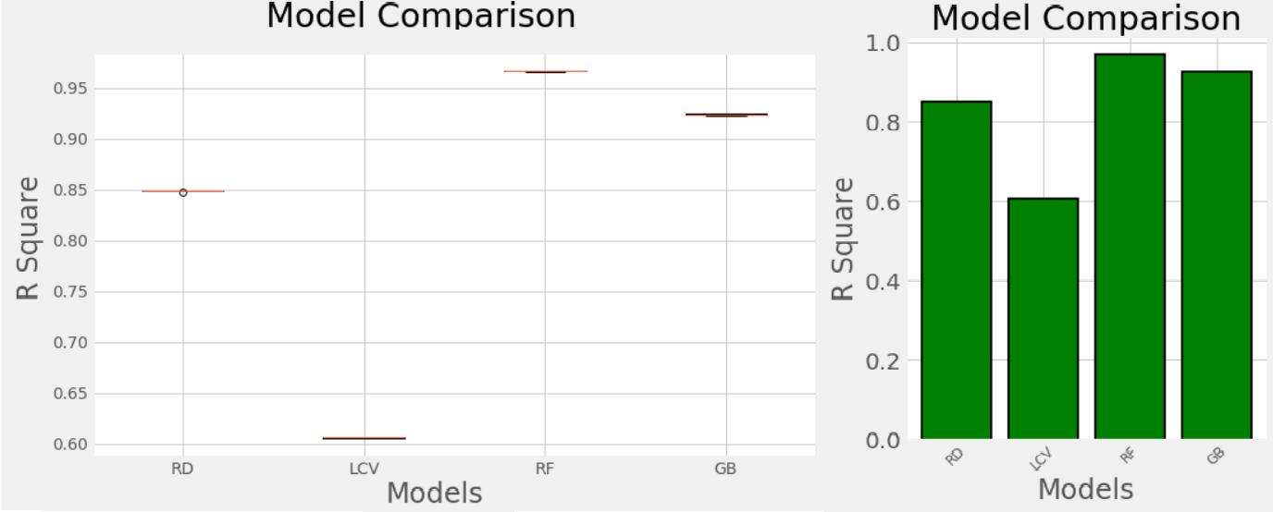
ML : Model Evaluation
Model Evaluation result by K-fold
 | CV1 | CV2 | CV3 | CV4 | CV5
RD | 0.847774 | 0.848656 | 0.848949 | 0.848799 | 0.848521
LCV | 0.604713 | 0.60523 | 0.606447 | 0.60607 | 0.606141
RF | 0.966181 | 0.966406 | 0.966495 | 0.966441 | 0.966278
GB | 0.924355 | 0.923462 | 0.924485 | 0.923539 | 0.923008
Evaluate different models on Training dataset using 5-fold cross-validation technique
Evaluated ‘Ridge (RD)’, ‘LassoCV (LCV)’, ‘Random Forest (RF)’ and ‘Gradient Boost (GB)’
Random forest produced the best R-Square of 0.966 comparing to other models. So we concentrate on Random Forest to optimize the result and training time.

Slide 19
ML : Hyperparameter tuning (RF)
HyperParameters Values for different models
HyperParameters | Base Model Values | Random Search CV Values | Grid Search CV Values
bootstrap | TRUE | TRUE | TRUE
max_depth | NONE | 50 | 30
max_features | auto | auto | auto
min_samples_leaf | 1 | 1 | 1
min_samples_split | 2 | 50 | 10
n_estimators | 10 | 120 | 150
Validation Test Run Results
Mean Absolute Error | 0.0634619 | 0.059109038 | 0.059177773
Mean Square Error | 0.0117556 | 0.00838429 | 0.008342143
R square | 0.9588077 | 0.970620925 | 0.970768613
Accuracy | 95.88% | 99.14% | 99.14%
Split the 2014-2018 dataset into Train and validation dataset.
Run the base model with n_estimator = 10 and check its performance on our metrics
Run the Random Search and then Grid Search to tune the Hyperparameters.
Best performance was received after doing Grid Search CV.
Marginal difference then Random Search CV results

Slide 20
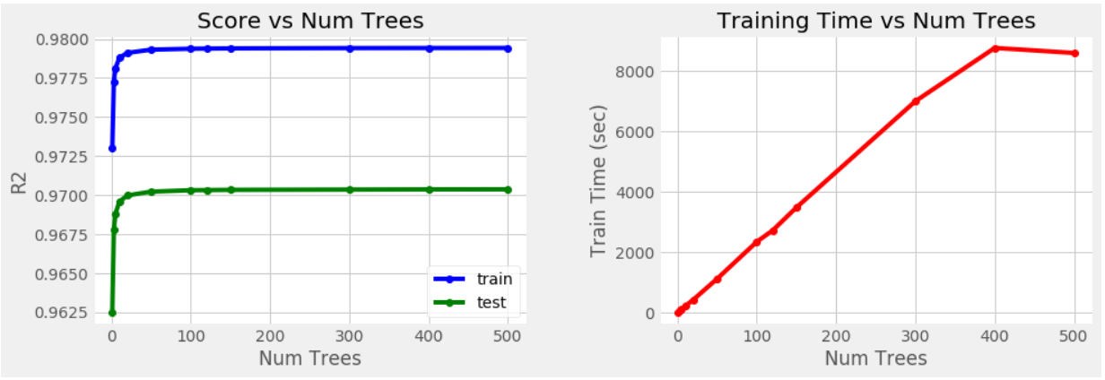
ML : Optimizing n_estimamtor
Kept all other best hyperparameters received from Grid Search CV, and try to tune the n_estimator.
As n_estimamtor increases there is not much difference in the performance.
Time to run the model increase steeply as we increase the number of trees.
Above graph suggest that the optimum number of trees seems to be 120.

Slide 21
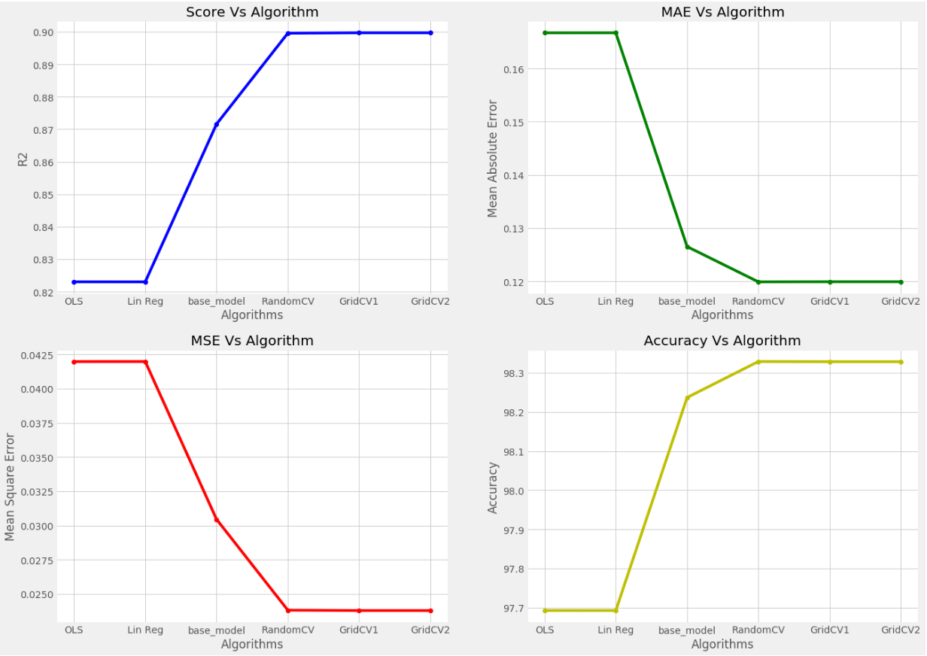
ML : Performance Evaluation on Hold-Out Data
All Models Performace on Hold Out Data
 | R2 | MAE | MSE | Accuracy
OLS | 0.823046 | 0.166688 | 0.041974 | 97.69262
Lin Reg | 0.823035 | 0.166697 | 0.041976 | 97.69254
base_model | 0.871604 | 0.126529 | 0.030456 | 98.23696
RandomCV | 0.899587 | 0.119905 | 0.023818 | 98.32891
GridCV1 | 0.899701 | 0.119929 | 0.023791 | 98.32855
GridCV2 | 0.899701 | 0.119929 | 0.023791 | 98.32854
Now run all the models on the Hold Out dataset and check their performances
Linear Models again did not perform well on the Hold-Out dataset.
As we search better Hyperparameters for Random Forest, we get better results on Hold-Out dataset.

Slide 22
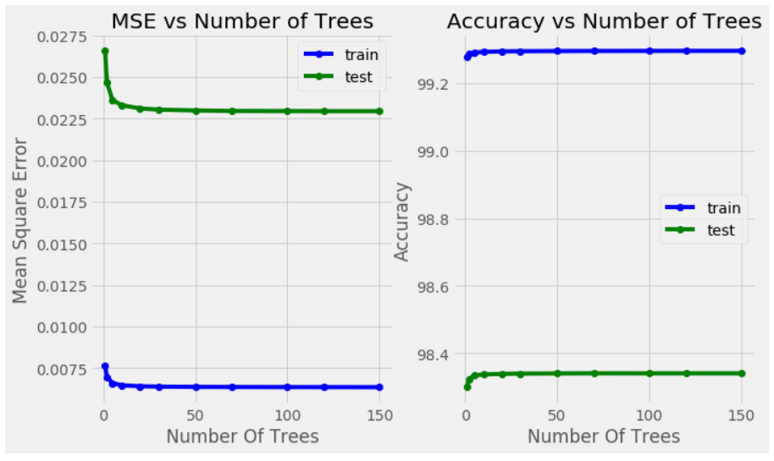
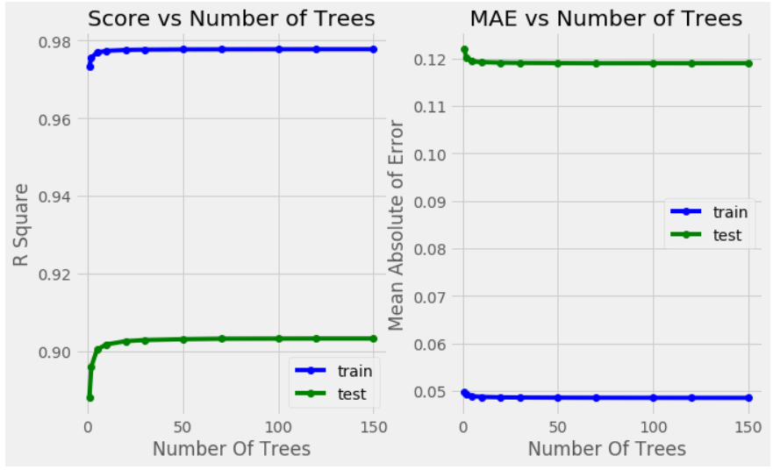
ML : Performance on Hold-Out Data Change only n_estimamtor
Ran the Random forest model with best HyperParameters received from Grid Search CV. Only changing the n_estimamtors from 1 to 150
This graph helps to trade off the accuracy of the model to expensive computational time.
There is not much difference in the R-square as we increase n_estimator =100

Slide 23
ML : Conclusion
Linear Models are not that accurate in predictions. Though It helped us in identifying the outliers in our dataset.
Among the Ensemble methods, Random forest is the best model for our dataset
Tune the hyperparameter for the Random forest using different cross validation dataset
Random Search CV helped us in narrow down the huge grid of hyperparameters with minimal grid
Grid Search CV is more stringent and search on all possible combination of the grid provided.
With Best parameters, we got the accuracy of 98.34% with R-Square as .9037 on our Hold Out dataset i.e. 2019 dataset.
We may get better result then this but with more computation and time.

Slide 24
Recommendations & Limitations & Suggestions
Recommendations:
Issuers can target states where the number of plans are less, to expand the business and can provided competitive monthly premium options.
The model can be scaled to predict the monthly premiums of family groups, like couple with one dependent and couple with two dependent and so on.
This helps in proper decision making for the consumers before buying heath insurance with their budget and kind of coverage they need.
Limitations:
There are few data points which cannot be shared in public platform because of PHI and HIPPA rules. These data points can help us in getting the better predictions for the premium.
Due to huge dataset, we limited our modeling to Florida State. Though EDA was done for whole Dataset
Suggestions:
Availability of data about the enrollment in the health insurance market place will help in better analysis, by comparing the actual enrollment with the available options.
Scale out the model to predict many other premium rates with family group option.
Dental plan considerations which was not part of this project.

Slide 25
Thank You!!
Any questions , suggestions or feedback will be appreciated

